Slide 1
FHIR Co-chairs report
Lloyd McKenzie
October 5th, 2015

Slide 2

DSTU 2 is Published
THANK YOU!!!!!

Slide 3
So now let’s talk 2.1 …
2 planned releases
2.1 is limited scope, interim release
Some resources and pages are “frozen”
Candidate “frozen” resources will be emailed out tonight
Substantive changes to “frozen” resources will require FMG approval
Based on feedback, final list will come out after Thur. Q4
Likely NOT for Jan. ballot

Slide 4
Release 3.0
Full release
Target is late 2017
Specific targets will be driven by scope, resources, etc.
Note: Substantive changes intended for 3.0 can’t be committed until 2.1 is published
Let FMG liaison know if this is a problem

Slide 5
SVN
SVN is still frozen except for approved technical corrections
Will soon be a DSTU 2.0 technical correction update
Let us know by end of week if there are issues that should be included
All deferred tracker items are now back to triaged
Can reconcile this week, just not commit

Slide 6
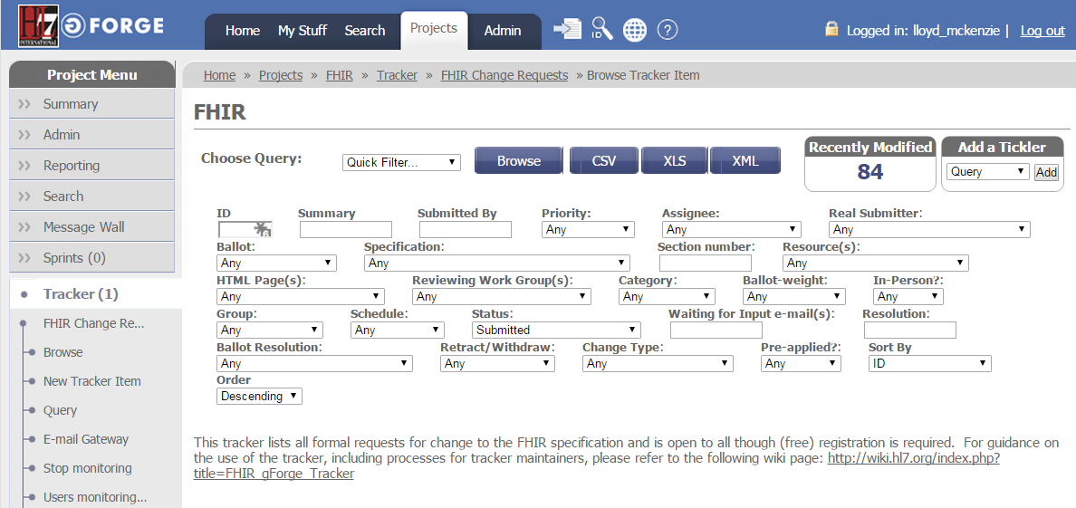
gForge help

Slide 7
gForge help
Common processes
Tools
Reports of tracker items by WG
Issues with tracker items
Extract a list of items for email/wiki
Extract to ballot spreadsheet
Soon coming
List of “tracker items of interest”

Slide 8
Feedback
Looking for feedback on use of gForge for balloting
Will feed back into the pilot review process
Looking for feedback on ballot process in general

Slide 9
Managing tracker items
Read the guidance on the link
If an item relates to a substantive change, resolution requires a vote
Even if not a ballot item or a negative
Whether persuasive, non-persuasive, deferred, etc.

Slide 10
This week
What are your plans for 2.1 and 3.0
How will you move up the FHIR maturity model
Candidate scenarios for connectathon
What is a reasonable timeframe for your intended 2.1 scope?

Slide 11
Workflow
Major focus of 2.1 scope
Sub-project being kicked off under FHIR Infrastructure
OO, FM, PA, PC, II, Pharmacy
Who else wants in? (email me)
Will test at Jan. Connectathon
Meeting Q3/Q4 in Orlando

Slide 12
Questions?

